Slide 1
Examining best practice methods for publishing structured data and linking government data
Dr Armin Haller
Australian Government Linked Data Working Group
Notes:
Hello to our last sessions for today. Thanks everyone for staying on for this talk. My name is Armin Haller, I am a lecturer at the Research School of Management at the ANU, but I was announced for the program as the Chair of the Australian Government Linked Data working group which I will be talking about today. Specifically, I will try to establish why it is extremely useful for government agencies to publish their data in a Linked data fashion.

Slide 2












Australian Government Linked Data Working Group
Community of Commonwealth Government experts and champions, with invited non-voting participation of individuals, corporations and other entities to:
Establish technical guidance publishing public sector information using Linked Data as a delivery technology
Determine governance rules and processes for the effective management of Australian Government Linked Data
Promote Linked Data across the Australian Government
Engender the development of Linked Data infrastructure
Notes:
Let me first give you a quick background on the group. We are a community of Commonwealth government experts and champions, with invited non-voting participants from other entities such as the NCI and Link Digital. The aim of the group is to establish technical guidance and governance rules around publishing public sector information using Linked Data. We also try to promote the use of Linked Data in the Government, which I am essentially doing today and we are trying to help with the setup of Linked Data infrastructure. We have formal members from, for example, the BoM, ABS, DHS, PM&C, CSIRO, NA and the ANU, but we are always interested to get contributions from more agencies.

Slide 3
Why Linked DATA for Publishing Public Sector Information?
Notes:
So why do we think it is a good idea to publish public sector information as linked data?

Slide 4
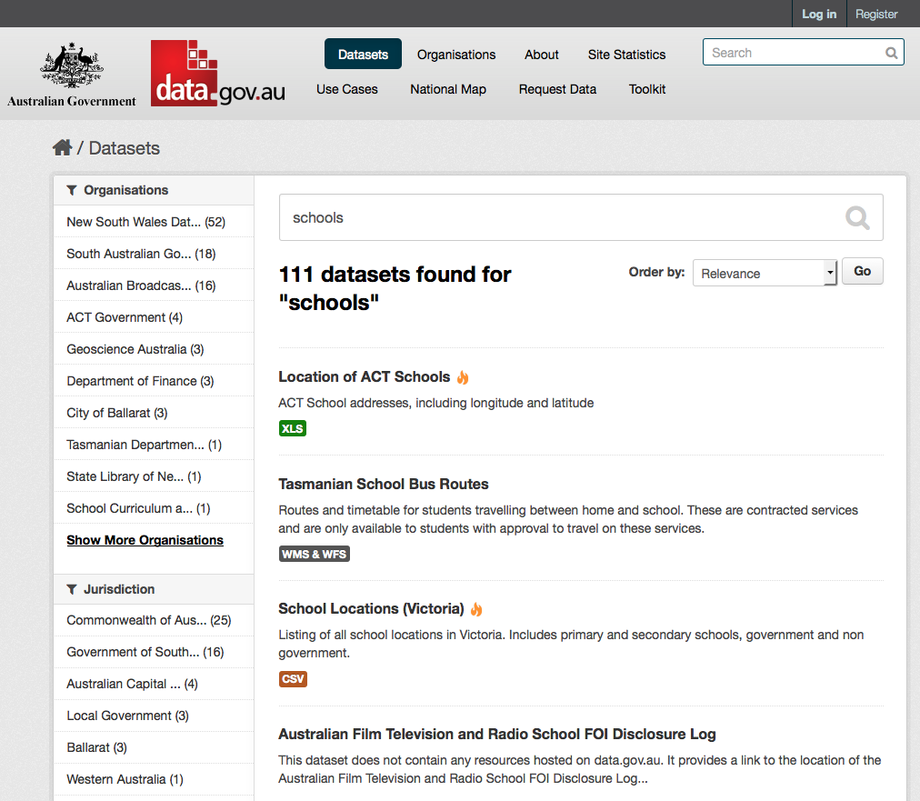
111 datasets
18 organisations
2 external data portals
3 levels of government
Notes:
Let’s look at an example. If you search for the keyword “schools” on data.gov.au, you get a result set of 111 datasets. These datasets stem from 18 different organisations, come from 2 additional external data portals, i.e. the portals of the states and from 3 levels of government.

Slide 5
Is data across these datasets referring to the same ‘THING’?
The concept of a ‘School’ (or ‘Primary School’, ‘High School’ etc.)
‘School’ attributes, such as a ‘catchment area’
A specific School, e.g. ‘Canberra Grammar’ and its:
longitudinal information
location information
NAPLAN test results
How can you reuse/link this information across datasets?
Notes:
Now do you think that there is some data in these 111 datasets that is overlapping, i.e. data that is referring to the same thing, for example, the same school or the same type of school, i.e. the concept school, or the concept primary school, high school. Maybe these datasets define some attributes of schools like catchment area, but maybe call that attribute differently. And if they are referring to the same school, maybe there is information redundant in different datasets. If you look at Canberra Grammar school, do you think this entity (THING) will be mentioned in different datasets. There is the ACT school dataset with its location information, but maybe there is another dataset with NAPLAN results that refers back to the same Canberra Grammar school.
So now if someone wants information about the Canberra Grammar school, how do you get all the relevant information about Canberra grammar. Looking at different datasets, looking through different schemas to potentially somehow integrate all this information yourself. Maybe there is an easier way to link information across datasets when the information is actually published.

Slide 6
We have a standardised method of reusing/linking documents on the Web
Hyperlinks
Notes:
There is such a mechanism on the World Wide Web for documents. Hyperlinks.

Slide 7
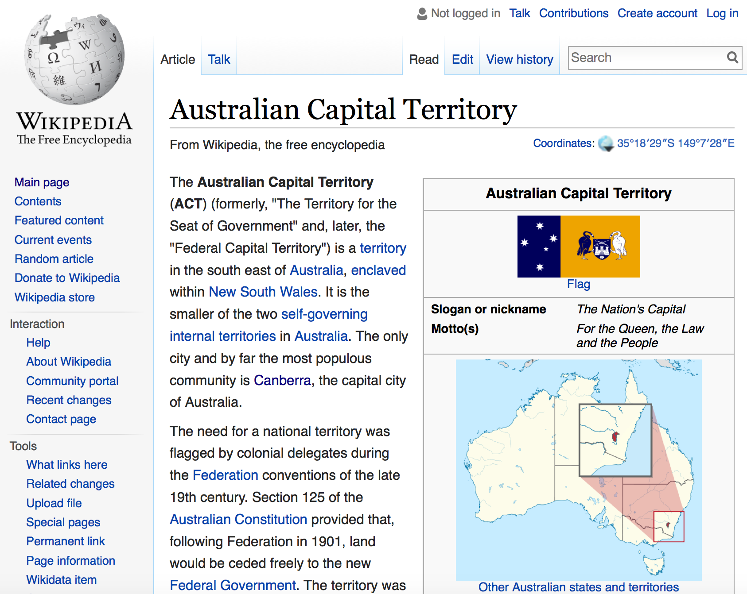
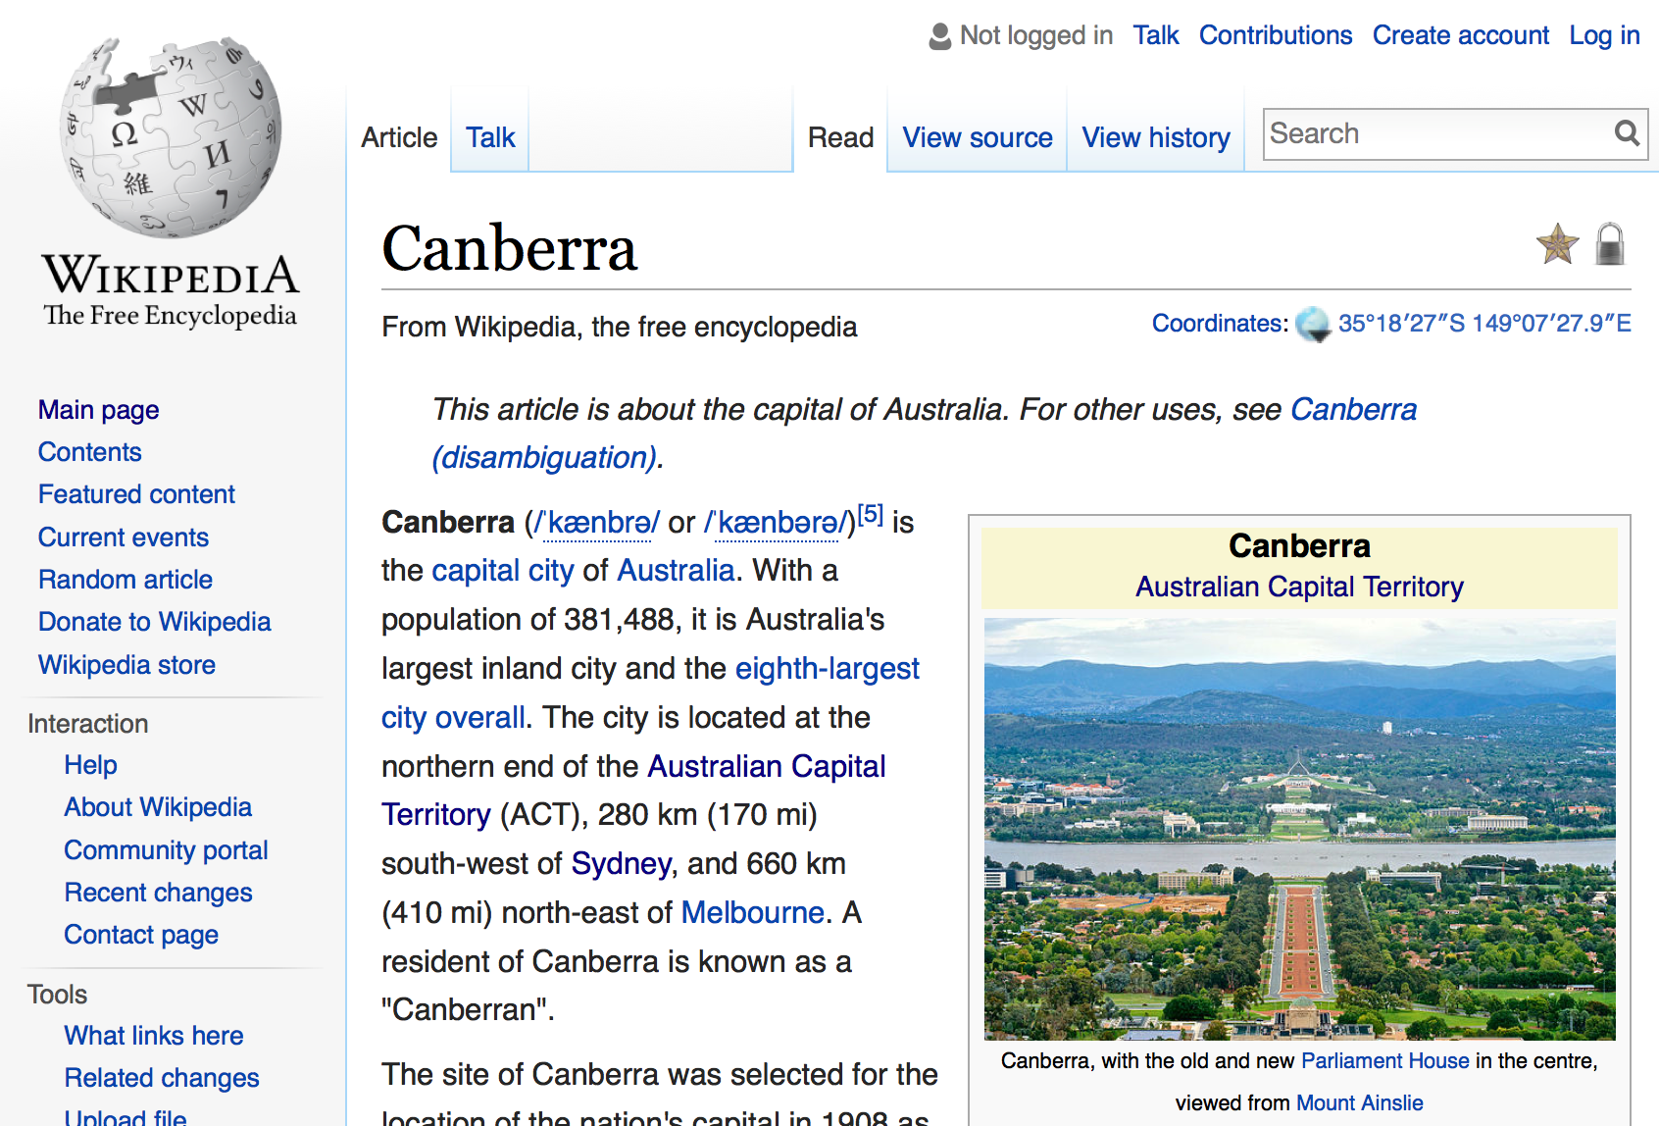
Traditional Web = Internet + Documents + Links
Notes:
When you look at a document on Wikipedia about Canberra there will be a reference to the Australian Capital Territory. But instead of reiterating all the information about the ACT on this page, the page links to another document, that describes the ACT. Other pages will also have links either to the ACT or Canberra, avoiding duplication of information while other websites can even point to the information on Wikipedia.

Slide 8
Can we use hyperlinks do link data?
Hyperlinks are used to link documents
We want to reuse/link ‘THINGS’
These ‘THINGS’ might be described in documents …
… but the information we publish is about the ‘THING’, not the document
Notes:
The problem with hyperlinks is that they link documents, not the actual data. So if we want to make statements about the actual THING, Canberra Grammar school in a dataset, hyperlinks are of no use to us. We want a mechanism where we can say, find more data about this specific thing in another dataset.

Slide 9
There is a standardised method of publishing data about ‘THINGS’ and reuse/link them
Linked Data
Notes:
There is a standardised method for doing exactly that, and it is called Linked Data.

Slide 10
Linked Data principles
Use URIs to name ‘THINGS’
Use URLs for those ‘THINGS’ if possible
Provide useful information at that URL
Include links to other ‘THINGS’
Notes:
So what is Linked Data. It is essentially a set of four best practises that were first introduced by Sir Tim Berners Lee, the same guy who invented the World Wide Web.
And they are:
Use URIs to name things such as the Canberrra Grammar School
Put these URIs on the Web, making them URLs
Provide useful information at that URL
And include links to other things.
In the next couple of minutes I want to go through these four points in a bit more detail.

Slide 11
1. Use URIs to name ‘THINGS’
URI – Uniform Resource Identifier
Compact sequence of characters …
… identifies an abstract or physical resource
[RFC3986]
In Linked Data Web → URI = URL http://lab.environment.data.gov.au/id/acorn-system/Adelaide_023090_023000
Notes:
Starting with the first principle, we need to ascertain first what a URI is. A URI, Uniform Resource Identifier, is a compact sequence of characters that can be used to identify and abstract or physical resource. This means, you can use URIs for all kind of things, but the really important characteristic of a URI is, that it is globally unique.
In the Linked Data sense a URI should also be a URL, but more to that in a second. So how does a URI look like, the one on this slide, lab.environment.data.gov.au/ and so on identifies a measurement station in Adelaide that is operated by the Bureau of Meteorology. If you type this URI in your browser, you get to a page that describes that thing.

Slide 12
1. Use URIs to name ‘THINGS’
Identifying and naming real-world and abstract ‘THINGS’ with URIs is extremely powerful, because:
it does not require any up-front agreement as you are the owner of that URI
others can reuse the URI and make further/other statements about that ‘THING’
Notes:
So why is it a good idea to name things with a URI. It is powerful, because it does not require any up-front agreement with anyone, because you are the owner of that URI. You can make statements about that Thing and if people agree with you, they will reuse your identifier, i.e. your URI.

Slide 13
1. Use URIs to name ‘THINGS’
Government agencies already keep lists of identifiers for ‘THINGs’ they are responsible for
URIs are required for ‘THINGS’
people, places, companies, products, roads, hospitals, schools, events, natural resources, etc.
e.g. ‘ACT school location dataset’
uses 2060 as identifier for ‘Canberra Grammar School’
a better identifier would be: http://education.data.act.gov.au/id/school/2060
Notes:
So why should government agencies use URIs to name things. Because government agencies are responsible to identify a lot of different things, such as places, companies, products, roads, hospitals, natural resources, etc.
For example, the ACT government has already given an identifier to the Canberra Grammar School. The identifier is 2060, which is weird, because it does not coincide with the postcode of Red Hill is ambiguous of course, as many things have an identifier 2060. However, if the dataset would give the Canberra Grammar School an identifier of education.data.act.gov.au/id/school/2060, it would be unique and others could use that identifier to refer to Canberra Grammar school.

Slide 14
2. Use URLs for those ‘THINGS’ if possible
Put information about these ‘THINGS’ on your website
i.e. when I type …
http://education.data.act.gov.au/id/school/2060
… in my browser I should get some information about Canberra Grammar school
Notes:
Once you have assigned a URI to a thing, you should put some information up on your webpage that describes the thing on the Web. So in the Canberra Grammar example, if you type in the URI in your browser, you should get some information about Canberra Grammar School. Obviously, this URI does not work, because I made up this URI.

Slide 15
3. Provide useful information at that URL
Use knowledge representation languages (RDF/OWL) to …
… make statements about resources (‘THINGS’) in the form of Subject–Predicate–Object expressions:
Subject | Predicate | Object
http://dbpedia.org/resource/Canberra | Is capital of | http://dbpedia.org/resource/Australia
http://dbpedia.org/resource/Canberra_Grammar_School | is located in | http://dbpedia.org/resource/Canberra
Notes:
So what information should you provide. If you follow the Linked Data principles, you should use a knowledge representation language such as RDF or OWL to do that. I am not going into details what these language allow you to do, but the essential characteristic is that you make statements in the form of subject predicate object expressions in these languages. So if you want to say something about Canberra, you could make statements such as that this URI that represent Canberra is the capital of Australia, represented by this URI on the right side.
And then you can make a statement that Canberra Grammar School is located in Canberra.

Slide 16
3. Provide useful information at that URL
Assign meaning to ‘THINGS’ through ontologies (vocabularies)
set of concepts (shared objects)
relationships between those concepts (shared predicates)
e.g. Schema.org ontology (vocabulary)
School Concept
URI – https://schema.org/School
A perspective of the concept via attributes / properties: address, areaServed, legalName, location …
Notes:
When you make such statements you should use ontologies, or simply you could call them vocabularies that define shared objects and shared predicates. Shared means if you use the ontology, you share the meaning of the object and the meaning of the predicate with the author of that ontology. If you look at schema.org, a vocabulary published by Google, it defines a School concept with a URI schema.org/School that gives you a perspective on the concept school via attributes such as address, areaServed, LegalName, location etc. All these attributes you probably agree are useful to describe a school, so you may reuse this concept from the School vocabulary from Google to describe your School.

Slide 17
3. Provide useful information at that URL
e.g. snippet of “Location of ACT Schools” dataset on https://data.gov.au
id | inst_name | l_addr_1 | l_addr_2 | l_pcode | cmps_lvl | affiliation | long | lat
2047 | Holy Trinity Primary School | Theodore Street | CURTIN | 2605 | Primary | Catholic, Roman | 149.081951 | -35.327679
2050 | Sts Peter and Paul's Primary School | Wisdom Street | GARRAN | 2605 | Primary | Catholic, Roman | 149.092732 | -35.339376
2056 | St Bede's Primary School | Hicks Street | RED HILL | 2603 | Primary | Catholic, Roman | 149.128788 | -35.338847
2058 | Rosary Primary School | Fleming Street | WATSON | 2602 | Primary | Catholic, Roman | 149.154682 | -35.24641
2060 | Canberra Grammar School | Monaro Crescent | RED HILL | 2603 | Combined | Anglican | 149.124674 | -35.330919
2061 | Canberra Girls' Grammar School | Melbourne Avenue | DEAKIN | 2600 | Combined | Anglican | 149.115115 | -35.31699
Notes:
So how would you do that. If you look at the Excel file of the Location of the ACT schools dataset you see the labels that the author of this dataset has given to some of the attributes. For l_pcode for postcode of the address of the school or long and lat to describe the longitude and latitude of where the school is located.

Slide 18
3. Provide useful information at that URL
Use ontologies to assign meaning to ‘THINGS’ in this dataset
Use for example new ‘CSV on the Web format’
metadata vocabulary to describe CSV data (structure, annotations, etc.)
mapping content to RDF, JSON, XML
Notes:
Now wouldn’t it be better to assign meaning to such attributes through established ontologies such as the one from Google.
To do that, you could use the new CSV on the Web format, which is just an extension to your traditional CSV format that you may use to save tables. CSV on the Web allows you to label your columns, or attributes through ontologies.

Slide 19
3. Provide useful information at that URL
http://www.w3.org/2003/01/geo/ wgs84_pos#long
http://www.w3.org/2003/01/geo/ wgs84_pos#lat
http://dbpedia.org/ontology/postalCode
https://schema.org/School
id | inst_name | l_addr_1 | l_addr_2 | l_pcode | cmps_lvl | affiliation | long | lat
2047 | Holy Trinity Primary School | Theodore Street | CURTIN | 2605 | Primary | Catholic, Roman | 149.081951 | -35.327679
2050 | Sts Peter and Paul's Primary School | Wisdom Street | GARRAN | 2605 | Primary | Catholic, Roman | 149.092732 | -35.339376
2056 | St Bede's Primary School | Hicks Street | RED HILL | 2603 | Primary | Catholic, Roman | 149.128788 | -35.338847
2058 | Rosary Primary School | Fleming Street | WATSON | 2602 | Primary | Catholic, Roman | 149.154682 | -35.24641
2060 | Canberra Grammar School | Monaro Crescent | RED HILL | 2603 | Combined | Anglican | 149.124674 | -35.330919
2061 | Canberra Girls' Grammar School | Melbourne Avenue | DEAKIN | 2600 | Combined | Anglican | 149.115115 | -35.31699
Notes:
So you could, for example, refer to a the postcalCode concept defined by dbpedia (a Linked data version of wikipedia) to denote the postcode of schools in this dataset. Or the Geonames vocabulary to denote the longitude and latitude of the schools in the dataset.

Slide 20
4. Include links
Identifying things with URIs works best when everyone uses the same URI to mean the same thing
In practice that generally means you still define your own URI for a ‘THING’, but link to a URI describing the same ‘THING’
http://education.data.gov.au/ id/school/2060
owl:sameAs
http://dbpedia.org/resource/ Canberra_Grammar_School
Notes:
Finally, the last principle for Linked Data is that you link to other datasets. For example, if you made up your own identifier for Canberra Grammar, you could link to other datasets that identify the same thing, namely Canberra grammar school. For example you could link to the dbpedia dataset again, which defines also Canberra Grammar School. You would do that with an equivalence relationship using the OWL language.

Slide 21
the Role of the Australian Government Linked Data Working Group
Notes:
So what role does the Australian Government Linked Data Working Group play here.
21

Slide 22


Government wide guidelines for URIs
URIs are cool if they are:
Readable
http://environment.data.gov.au/weather/000478 → http://environment.data.gov.au/weather/id/station/000478
Unambiguous
http://location.data.gov.au/id/carlton → http://location.data.gov.au/id/vic/carlton
Include no implementation details
http://education.data.gov.au/index.php?type=school&id=2600 → http://education.data.gov.au/id/school/2060
Maintained! → even if content moves or is deleted (e.g. MoG), server should respond appropriately
… and broken links are very uncool
Notes:
First we published some guidelines on how to name things with URIs. You want to have cool URIs when you name things. So what are cool URIs. First, they should be readable to a human. Environment.data.gov.au/weather/000478 is not readable. What does 000478 stand for. If you had a URI for the same thing, /weather/id/station/000478 you would know that the id stands for a weather station.
It should also be unambiguous. If you had /id/carlton, does it refer to the suburb in sydney or the one in Melbourne, so a better URI would be location.data.gov.au/id/vic/carlton.
It should also not include any implementation details such as index.pho?type etc.
And most importantly, it should be maintained. If you defined it, you should be prepared to run it forever. So don’t include your department name in it.

Slide 23
Proposed URI guidelines
Index of a Dataset: Identifier that names a Linked dataset and provides metadata of the dataset.
Real-world ‘Things’ Identifier: Physical and abstract ‘Things’ that may be referred to in statements.
Document Identifier: Information on the web about Real World ‘Things’
Vocabulary identifiers (ontologies, concepts etc.): URIs for classes and properties describing real-world things
/dataset[/{module}]*/{datasetid} → /dataset/act/schools [Metadata for School Dataset]
/id/{type}/{name} → /id/school/2060 [Canberra Grammar]
/doc/{type}/{name} → /doc/school/2060 [Document about Canberra Grammar]
/def/{scheme}/{concept} → /def/school/phaseOfEducation [Class definition]
Notes:
So our group has published a document that defines some guidelines around how you should name things if you as a government agency publish information about a thing. I don’t want to go into details here, but what you can see here are some of the guidelines and how we distinguish between datasets, real world things, documents and vocabularies.

Slide 24
Example Australian Government Linked Data
Notes:
Members of our group have also published already several datasets that use Linked Data principles and the guidelines developed in our group.
24

Slide 25
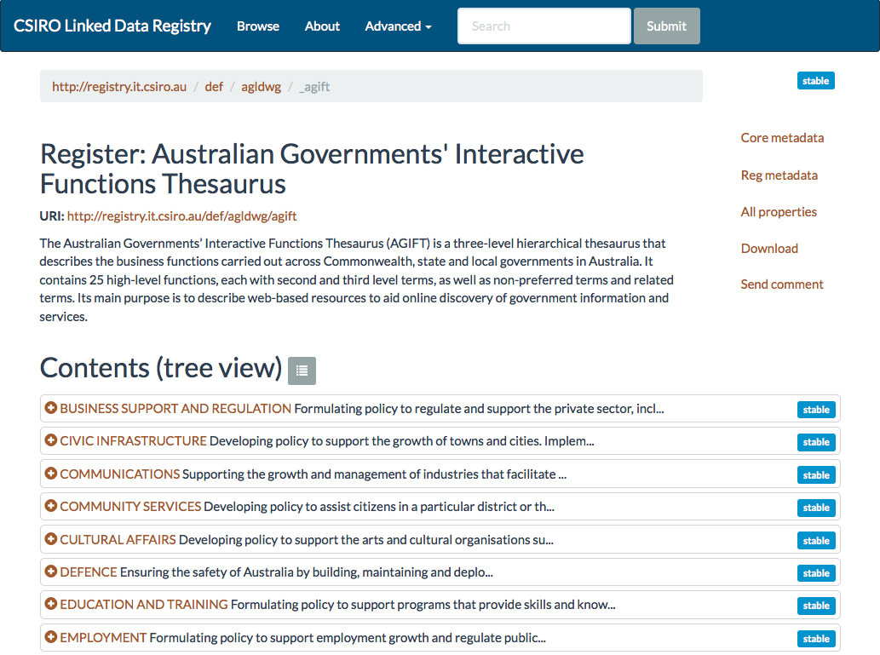
Australian Governments’ Interactive Functions Thesaurus (AGIFT)
Published by National Archives
Used to classify Linked Datasets in the AGLDWG URI guidelines
http://registry.it.csiro.au/def/agldwg/agift
Notes:
One of them is the Australian Government Interactive Functions Thesaurus which is published by the National Archives. There is a linked data version of it available from the address below and the National Archives also plans to publish the same Linked Data version in the coming months. Why is this important, because we use that thesaurus as a guideline to classify datasets, for example using the top level thesaurus such as communications, defence, education etc. for the subdomain in data.gov.au.

Slide 26
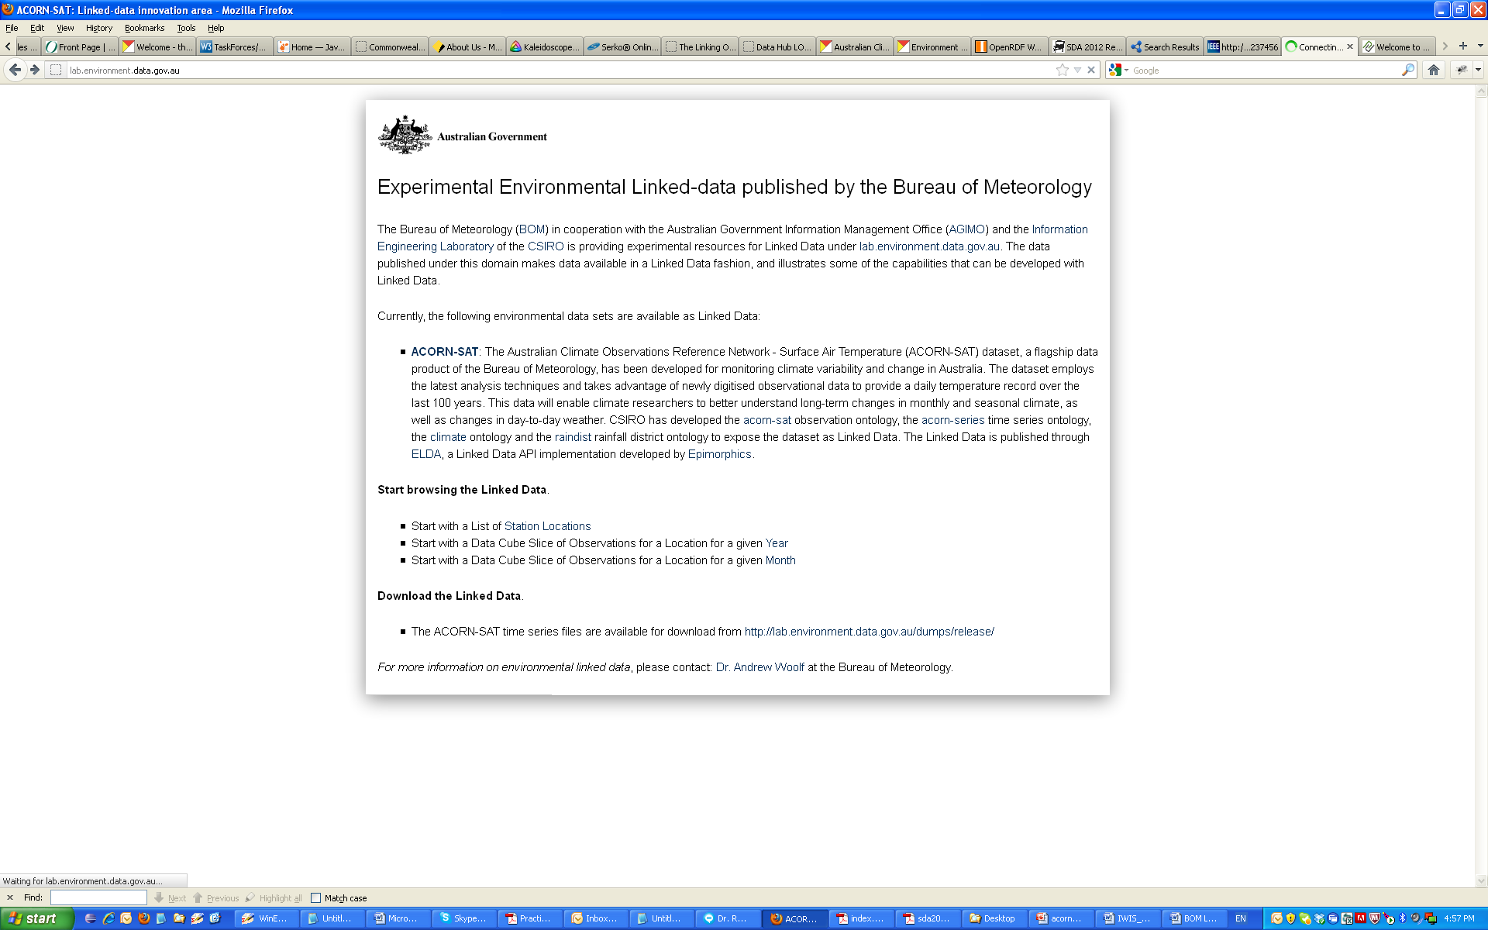
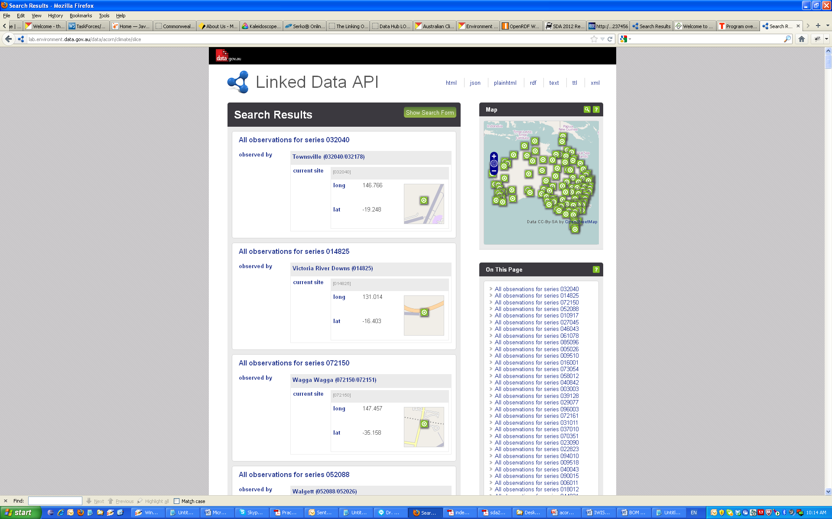
ACORN-SAT Linked Data
http://lab.environment.data.gov.au
Notes:
Another example Linked data implementation is from the Bureau of Meteorology. The BoM has published ACORN-SAT a long term climate dataset as Linked Data at the URL lab.environment.data.gov.au. It was the first Linked Dataset by the Australian Government and won some iAwards.

Slide 27
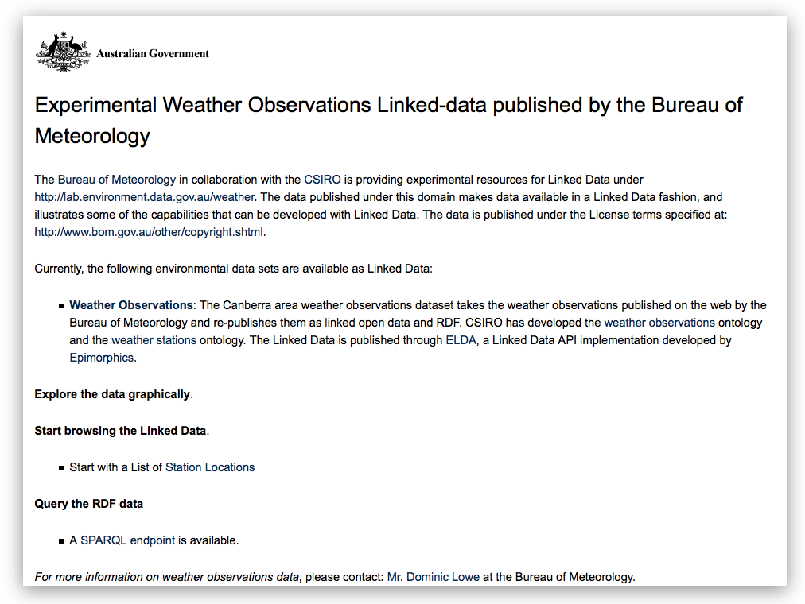
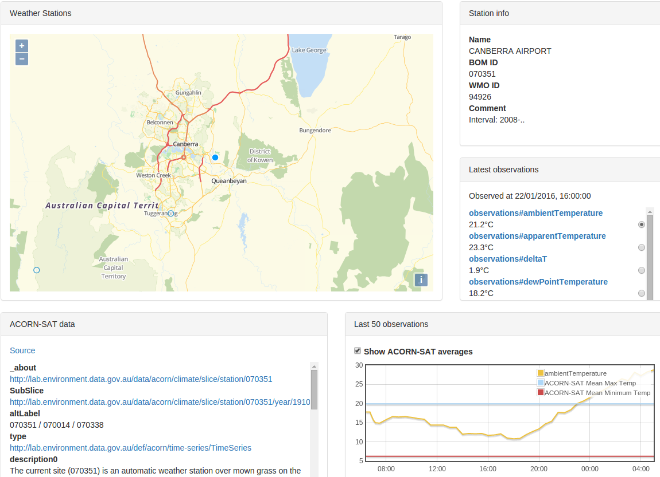
Weather Observations Linked Data
http://lab.environment.data.gov.au/weather
Notes:
Extending this dataset, another effort by the BoM has been recently published under lab.environment.data.gov.au/weather which publishes current weather observations for seventeen weather stations in NSW and the ACT as Linked Data.

Slide 28
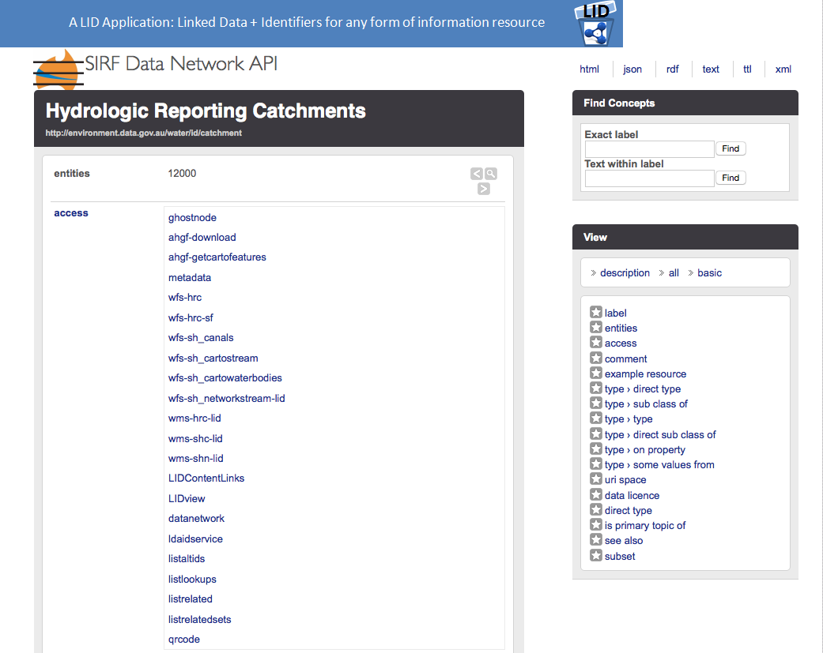
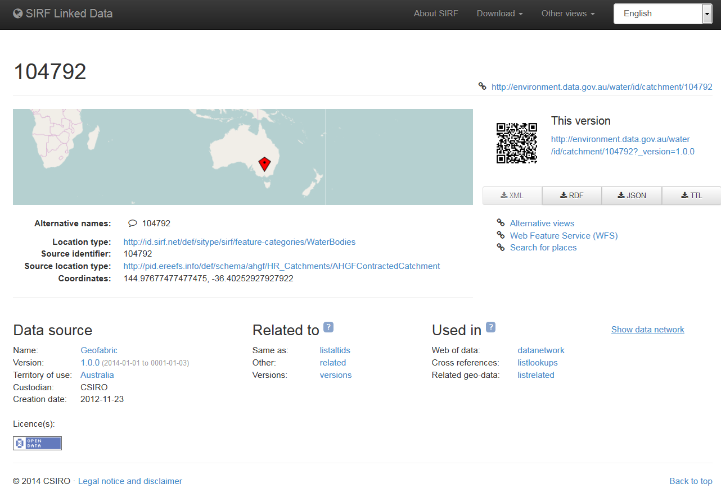
Australian Hydrological Geospatial Fabric (Geofabric) Linked Data
http://environment.data.gov.au/water/id/catchment
Notes:
The last example is the Australian Hydrological Geospatial Fabric Linked Data, build by the the BoM and CSIRO which is a set of 6 inter-related data products showing Australia’s rivers and surface water as images, maps and node networks.

Slide 29
Questions?
http://linked.data.gov.au
https://github.com/AGLDWG

